Slide 1
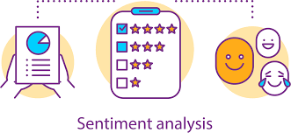
Customer Sentiment Analysis
Amazon food items
Akanksha Arora
Suranjana Chowdhury
Xiaohong Liu
Sai Meghana Reddy Devarapalli

Slide 2

Agenda:
Q1
Data Pre-processing & Exploratory analysis
Conclusions
Problem Statement and Objective
Algorithms, Analysis, and Implementations
Game Description
Analysis Procedure
Q2
Notes:
Charanya

Slide 3
Sentiment Analysis

Slide 4
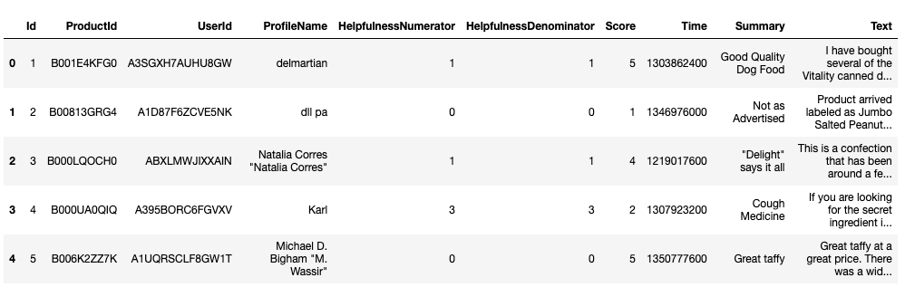
Objective
Customer Sentiment Analysis using RNN
To train and build a neural network model (RNN) which can accurately predict sentiments of customer reviews
What customers think of the products?
Detect issues based on reviews and act upon them
Dataset considered : Amazon fine food review

Slide 5
Dataset - Overview
Amazon fine food reviews
Dataset consists of reviews of fine foods from amazon
Time Period: Oct 1999 - Oct 2012
568,454
265,049
74,258
Reviews
Users
Products
-- 10 columns --
Products Id
Review text
Summary of review
User Id
Product
Ratings/score

Slide 6


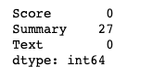
Data Pre-processing
Duplicates
Identify Important features
1
2
No duplicates
ID
Product ID
User ID
Profile Name
HelpfulnessDenominator
Score
Time
Summary
Text
Missing Values
3
Keeping 3 out of 10 columns
Summary has 27 missing values, but since other two columns are non-empty; we shall not remove them

Slide 7
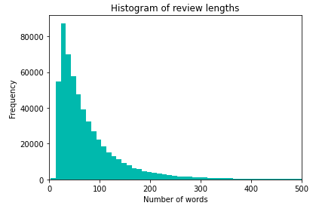
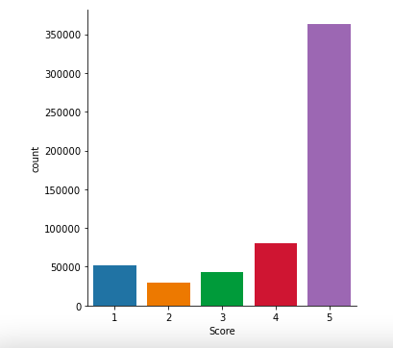
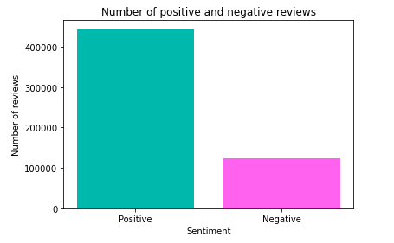
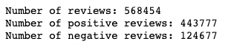
Data Exploration
Most of the reviews are 20-40 words long
Average length: 80 words
Majority of the data has >5 score
Positive reviews > negative reviews
The model will be Biased
Score = 4, 5 Positive (~86%)
Score =1, 2, 3 Negative (~14%)

Slide 8
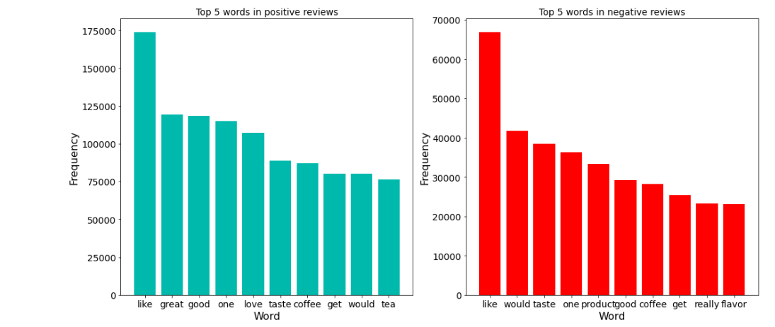
Data Exploration
Positive reviews tend to include words like great, good, love etc.
Negative reviews also have similar top words as positive reviews
But do not have adjectives like good, great..

Slide 9
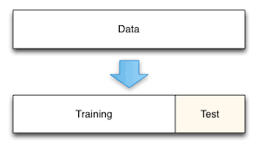
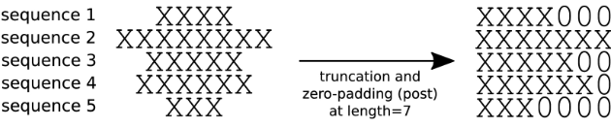
Algorithm
Split the data into training (80%) and testing (20%)
Tokenizer: change words (text) to a number sequence
Padding: Make sequences of same length
Vocabulary: 2000
(most frequent words to be kept in library)
1 is out of vocabulary
[[9, 10, 20, 180, 120, 11, 1]]
Max length: 50

Slide 10
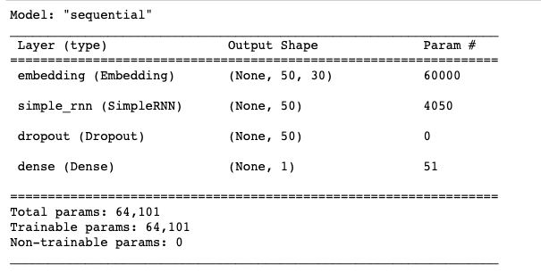
Model Fitting
Model Used:
Embedding:
Dropout probability:
Dense layer:
Optimizer:
RNN model (CNN) used to predict if review is good or bad
Decrease the dimension for easy calculation
0.2 (to avoid overfitting)
Sigmoid (binary class)
Adam
sequential RNN model

Slide 11
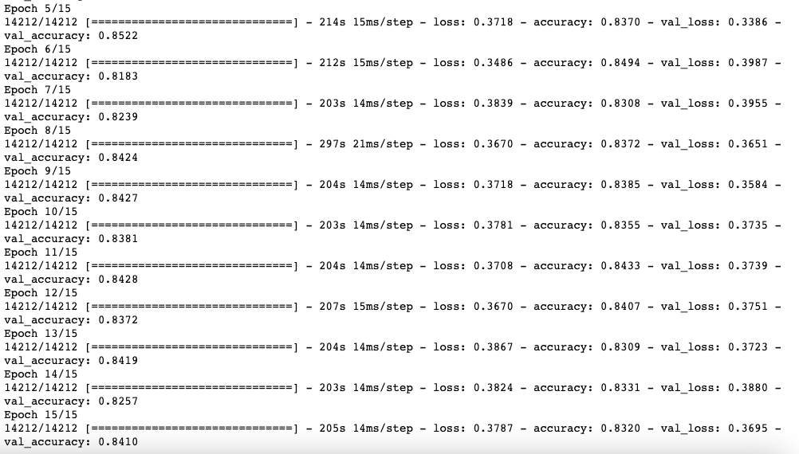
Compilation & Model Fitting
15 Epochs: Dataset is passed through network during training 15 times
Test accuracy ~84%
Training accuracy ~83%
We move ahead with results of epoch 15

Slide 12
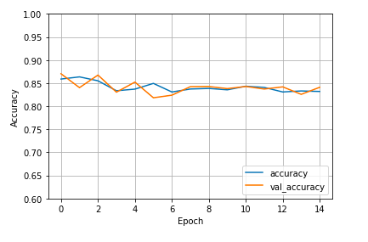
Results
Conclusion:
 | Accuracy | Loss
Training | 0.8320 | 0.3787
Test | 0.8410 | 0.3695
Given a review, we can predict with ~85% accuracy if it is a positive or a negative review

Slide 13
Conclusions and Suggestions
"the product is good, but it would be a better idea to add some decor to it"
Positive
1
"not the worst deal but neither the best one, such a horrible packing"
Negative
2
"the is the best deal of my life”
3
Positive
"haven’t seen anything like this before”
Positive
4
Reviews 2,3 and 4 are very clear if they are positive or negative and model accurately predicted them
Review 1 looks like a balanced review, and hence model put it as positive
Using the model, a string of reviews pertaining to a products can be parsed to judge the common sentiment
Negative reviews can be studied to figure out the issue and rectify them

Slide 14
Reinforcement Learning

Slide 15
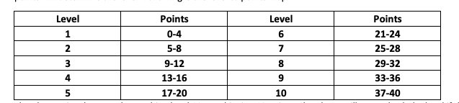
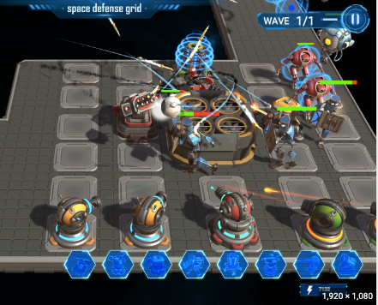
THE LAST KINGDOM
Game Description
Start of the game
Actions
Rewards
Game ends
Enemy
waves
Strategy game
Build tower defense
Defeat enemy waves
Player at Level 1
10 coins
20 grid spaces
1 coin -> 1 tower
Place towers
Upgrade towers
Change position of towers
Win
+1 point
+10 coins
+20 grid spaces
Loss
-1 point
-5 coins
No effect
Reach level 10
Have 40 points
State will be function of:
Enemy waves defeated,
Coins, points, grid spaces,
position & number of towers

Slide 16

Action Rule, State Distribution & Final Reward
Action Rule: Train agent to select an action that maximizes the expected future rewards, considering the current state and the available actions
State Distribution: Sliding window approach that considers the previous few states to capture temporal information
Cumulative rewards
Install tower in grid space 1 or 2 at some state St?
Agent will install at grid space 1 if higher reward
Window approach
Thus, if 10 enemy waves were dealt with, out of which 8 were defeated, the final reward would be 6 (+8-2) points, level 2, 70 (+80-10) coins, 20 more grid spaces
Reward: At end of episode (Series of actions)
Final Reward: Maximize the cumulative reward (coins, points, and grid spaces) it receives over time

Slide 17
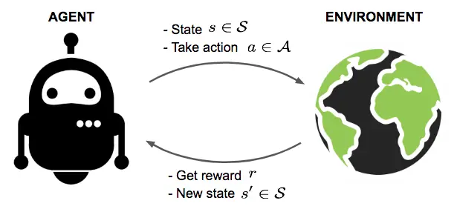
Analysis Procedure
Dueling Q-networks algorithm with ReLU activation functions
Make modifications, and retrain if required
Sliding window approach for state distribution
Guage agent’s success rate and game play
Train agent for 100,000 turns//epochs to begin
Test performace on predetermined scenarios

